Slide 1
OGC Testbed 21 – GIMI & Imagery Domain Ontology (IDO) Activities
Joe Stufflebeam, Ph.D.
GEOINT Media Standards Board
NGA/TAES Contractor
22 Jan 2026

Slide 2
OGC Testbed 21 – GIMI Focused Requirements
GIMI File Format:
Enable accelerated GIMI adoption and application development by participating in open-source additions to the GStreamer and libheif libraries
Develop a GIMI Conformance Test Tool
Imagery Domain Ontology (IDO):
Investigate, implement, and evaluate the GEOINT Media Standards Board’s (GMSB) emerging Imagery Domain Ontology (IDO) by implementing and testing ontology structured metadata sidecar files.
GIMI/IDO:
Develop a Cloud-based GIMI/IDO player/viewer to provide a general tool for accessing and viewing geospatial media content.

Slide 3




GIMI Files – High Level Overview
GIMI builds on ISO standards
Video files are MP4 files (video, timed metadata, and audio tracks)
Still imagery files are HEIF files (image and single instance metadata items)
Four elements of content are required in a GIMI file
Brand: identifies MP4 & HEIF files as meeting the requirements of
NGA.STND.0076 (GIMI). The GIMI brand is ‘geo1’
Security: carries ODNI defined ISM.XML security markings
Content IDs: uniquely identifies each piece of media content (globally)
Timestamps: nano-precision TAI timestamps, with timing metadata
‘geo1’
GIMI file

Slide 4
GIMI Supports the Containment of GEOINT Imagery & Ontology Structured Metadata
NGA.STND.0076 (GIMI) File
Content IDs and TAI timestamps link information together
Common to all GIMI Files
Media Content Options
RDF Triple Store Sidecar File
(External to GIMI file)
Still Image(s)
Branding
Container for Ontology Structured Metadata
Image Sequence(s)
ISM.XML Security Markings
Application Metadata
Motion Imagery Track(s)
Content ID
Content IDs
Application Metadata
TAI Timestamp
TAI Timestamps
Audio

Slide 5
Imagery Domain Ontology
The IDO provides a rich set of ontologically structured information geared toward providing descriptive information and context about GIMI imagery media content.
The initial IDO effort is focused on "Collection" and the parameters associated with sensor systems and the entities within a scene.
The IDO is part of a wider Government wide effort aimed at aligning data management and achieving cohesive understanding across different domains.

Slide 6
IDO is based on Basic Formal Ontology v2.0
Entity
Continuant
Occurrent
Specifically Dependent Continuant
Generically Dependent Continuant
Independent Continuant
Temporal Region
Spatiotemporal Region
Process Boundary
Process
Realizable Entity
Quality
Immaterial Entity
Material Entity
One-dimensional temporal region
Zero-dimensional temporal Region
History
Disposition
Role
Relational Quality
Site
Continuant Fiat Boundary
Spatial Region
Object
Object Aggregate
Fiat Object Part
*
*
*
*
*
*

Slide 7
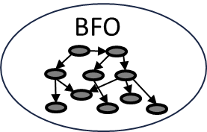
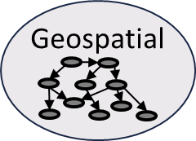
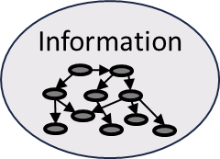
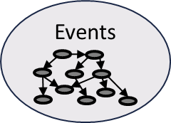
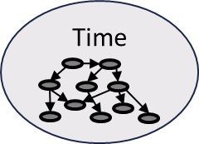
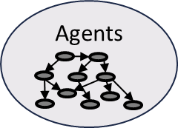

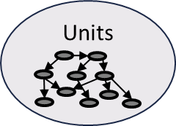



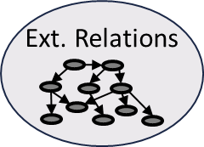
The Common Core Ontologies
Geospatial - Sites, spatial regions, and other entities, typically located near the Earth's surface, and the relations between them.
Information Entities - Generic types of information as well as the relationships between information and other entities.
Events - Processual entities, especially those performed by agents, occurring within multiple domains.
Time - Temporal regions and the relations holding between them.
Agents - Agents, especially persons and organizations, and their roles.
Qualities - Attributes of entities, especially qualities, realizable entities, and process profiles.
Units of Measure - Standard measurement units measuring various attributes of entities.
Currency - Currencies countries issue and use.
Facilities - Buildings and campuses serving some specific purpose and common to multiple domains.
Artifacts - Artifacts common to multiple domains, along with their models, specifications, and functions.
Extended Relations - Relations holding between entities at the level of the mid-level Common Core Ontologies.
https://github.com/CommonCoreOntology/CommonCoreOntologies

Slide 8


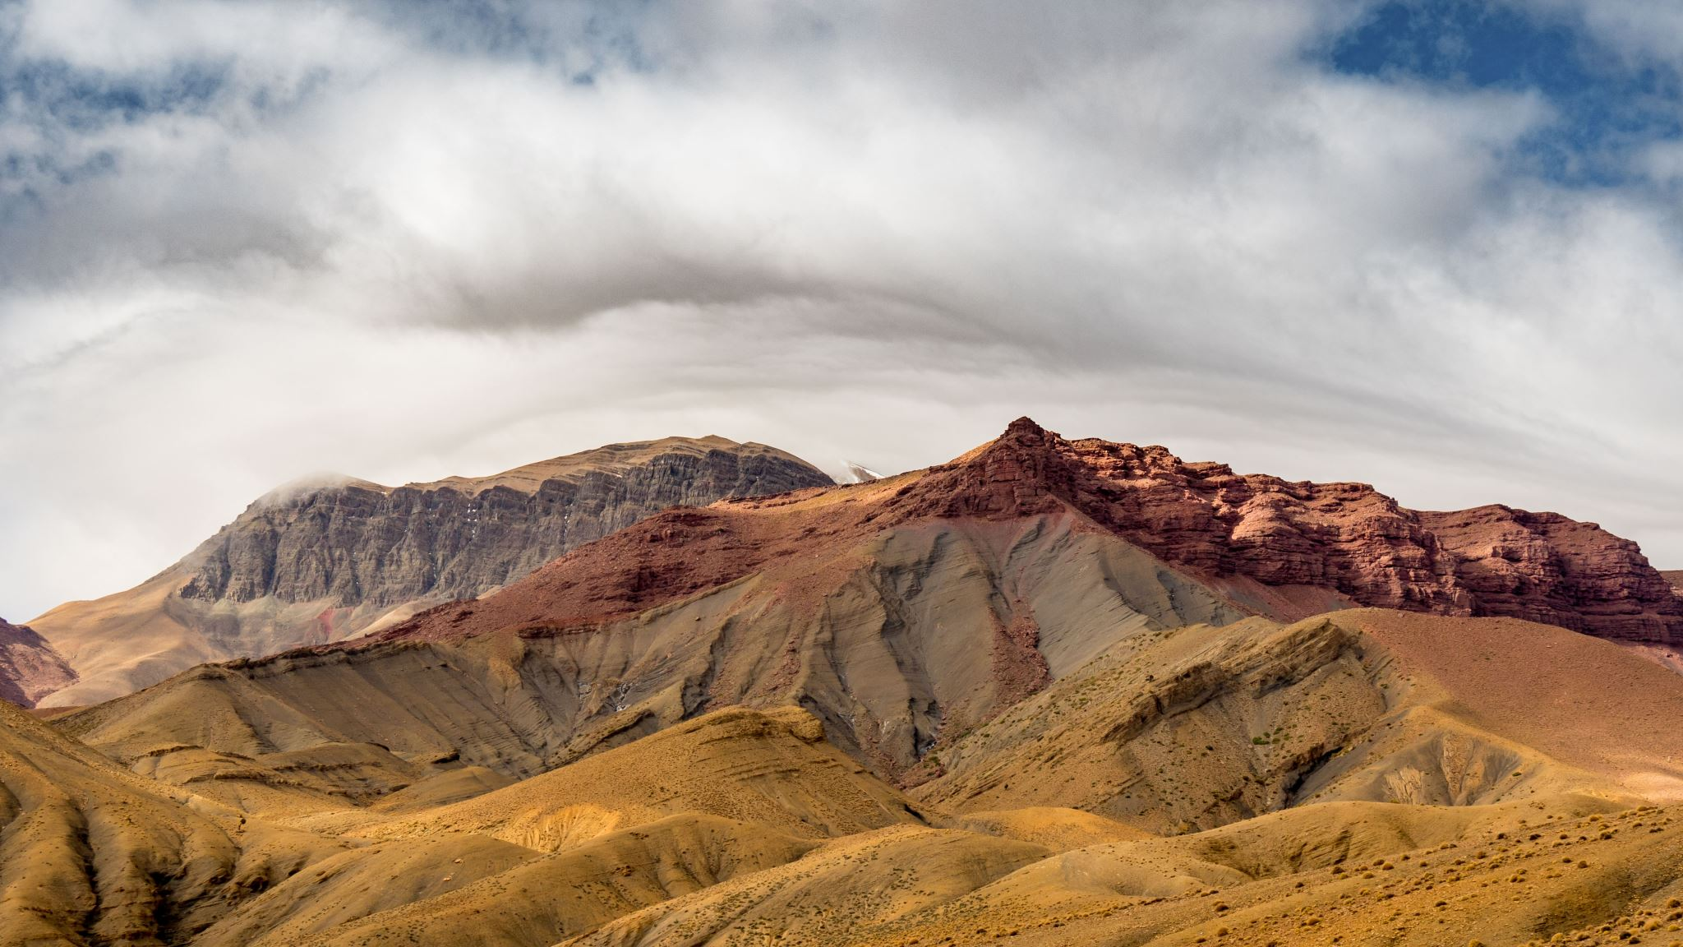

Generalized Imagery Domain Use Case
Illumination Source
Electromagnetic Radiation (EMR)
Illumination EMR
Has Spectral Composition
Photon to Electron Conversion Process
Image sensor readout process
EMR measurement device
Image sensor exposure process
Scene Entities
EMR measurement process
Noise processes
Radiating process
Scene
Scene EMR
Optical Assembly
Focused EMR
Camera
Atmosphere
Image Generation Process
Optical zooming process
Optical focusing process
EMR Capture process
EMR Projection
Image Sensor
Electron Counting
NUC
Gain & offset
Noise mitigation
Material Processes
Reflection
Transmission
Absorption
Scattering
Radiating
Material Properties
Emissivity
Reflectivity
etc.
Atmospheric Processes
Material processes
Turbulence
Atmosphere Properties
Transverse coherence length
Greenwood frequency
Isoplanatic angle
etc.
Digital Image
Trigger
has a
Timestamp Generation Process
TAI Timestamp
has a
Content ID Generation Process
Content ID
Image Annotation Process

Slide 9
Imagery Domain Ontologies as Building Blocks
BFO
Basic Formal Ontology
(Top-Level)
Common Core Ontologies (Mid-Level)
Imagery Domain Ontologies
(includes utilization of other shared ontologies)
Process Characteristics
Time
Uncertainty
Functions
Illumination Sources
Energy
Atmosphere
Optics
Noise
Sensor Models
Platforms
Military Equipment
Terrestrial Features
Cameras
Radiometry
Coordinates
Imagery

Slide 10
Summary
The OGC Testbed 21 is performing foundational work to enable and accelerate the availability of foundational tools necessary to realize the adoption and proliferation of the GIMI format and the Imagery Domain Ontologies.
These new technologies have been designed to significantly improve interoperability and technical capabilities across the broad spectrum of geospatial imagery applications and users.
The GEOINT Media Standards Board (GMSB) is very appreciative of the efforts and successes being achieved and demonstrated by OGC and the Testbed 21 participants.

Slide 11
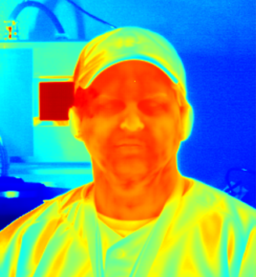
Joe Stufflebeam, Ph.D.
GEOINT Media Standards Board
NGA-TAEB Contractor Joe.stufflebeam@teknicare.com

